Slide 1
Testing Agile Based Software
Prof. Durga Prasad Mohapatra
Dept. of CSE, NIT Rourkela
India

Slide 2
Agile software Development: Motivation
There are many SDLC models available, such as waterfall model, prototyping model, iterative model, incremental model, spiral model and many more.
These traditional models follow the static working strategy in which everything is fixed, for example cost of project, requirements or scope, schedule etc. Further, the duration is in years.
Besides, there are several other drawbacks of each model.

Slide 3
Agile software Development
In order to overcome these drawbacks, several major software vendors have been adopting a form of ‘‘intelligent’’ development in one or more phases of their software development processes.
Agile for example, is a well-known example of a lifecycle used to build intelligent and analytical systems.
Agile development does not promote best practices; rather, it is about adaptive planning and evolutionary development.

Slide 4
What is Agile Software Development?
Agile: Easily moved, light, nimble, and active software processes.
How agility achieved?
Fitting the process to the project
Avoiding things that waste time
Notes:
Agile SE -> Agile SD
How many have heard of Agile Software Development?
What does the word Agile mean? Anyone?
Latin word agilis, which means “easily moved, light, nimble, active”.
3. Agile Software development – defined as easily moved, light, nimble, and active software processes.
(Agile processes are not unique to software development. They appeared in mainstream business literature in 1991 in the form of Agile manufacturing.)
4. Fitting the process… Not project to the process.
Battlefield commanders plan extensively when going to war -> but realize that their plans are just the beginning. Creating and responding to change are very important.
Success is defined by accomplishing the mission (defeating the enemy) not conforming to the plan.
Can you image a commander saying, “We lost the battle but by golly we were successful because we followed our plan to the letter.”
Or “If we just plan this battle long and hard enough, and put repeatable processes in place, we can eliminate change early and not have to deal with it later.”
Pretty unreasonable.

Slide 5
Agile software Development
ASD is based on light weight methodologies (less documentation and less planning) having dynamic nature, which is its major strength.
This model provides an environment to accommodate frequent changes as per market standards and customer needs.
ASD is an iterative and incremental development method and it is customer centred.

Slide 6
Agile software Development
The agile process consists of multiple sprints (iterations or runs or development cycles);
in each sprint a specific software feature is developed, tested, refined and documented.
However, because agile development depends on the context of the project,
testing is performed differently in every sprint.

Slide 7
Agile Model
To overcome the shortcomings of the waterfall model of development,
it was proposed in mid-1990s
The agile model was primarily designed:
To help projects to adapt to change requests
In the agile model:
The requirements are decomposed into many small incremental parts that can be developed over one to four weeks each.

Slide 8
History: The Agile Manifesto
On February 11-13, 2001, at The Lodge at Snowbird ski resort in the Wasatch mountains of Utah, seventeen people met to talk, ski, relax, and try to find common ground—and of course, to eat.
What emerged was the Agile ‘Software Development’ Manifesto.

Slide 9
History: The Agile Manifesto cont…
Representatives from Extreme Programming, SCRUM, DSDM, Adaptive Software Development, Crystal, Feature-Driven Development, Pragmatic Programming, and others sympathetic to the need for an alternative to documentation driven, heavyweight software development processes convened.

Slide 10
History: The Agile Manifesto cont…
Now, a bigger gathering of organizational anarchists would be hard to find, so what emerged from this meeting was symbolic—a Manifesto for Agile Software Development—signed by all participants.

Slide 11
Manifesto for Agile Software Development
We are uncovering better ways of developing
software by doing it and helping others do it.
Through this work we have come to value:
Individuals and interactions over processes and tools
Working software over comprehensive documentation
Customer collaboration over contract negotiation
Responding to change over following a plan
That is, while there is value in the items on
the right, we value the items on the left more.

Slide 12
Principles behind the Agile Manifesto
Our highest priority is to satisfy the customer through early and continuous delivery of valuable software.
Welcome changing requirements, even late in development. Agile processes harness change for the customer's competitive advantage.
Deliver working software frequently, from a couple of weeks to a couple of months, with a preference to the shorter timescale.

Slide 13
Principles behind the Agile Manifesto cont…
Business people and developers must work together daily throughout the project.
Build projects around motivated individuals, give them the environment and support they need, and trust them to get the job done.

Slide 14
Principles behind the Agile Manifesto cont…
The most efficient and effective method of conveying information to and within a development team is face-to-face conversation.
Working software is the primary measure of progress.
Agile processes promote sustainable development. The sponsors, developers, and users should be able to maintain a constant pace indefinitely.

Slide 15
Principles behind the Agile Manifesto cont…
Continuous attention to technical excellence and good design enhances agility.
Simplicity--the art of maximizing the amount of work not done--is essential.
The best architectures, requirements, and designs emerge from self-organizing teams.
At regular intervals, the team reflects on how to become more effective, then tunes and adjusts its behaviour accordingly

Slide 16
Ideology: Agile Manifesto
Individuals and interactions over
process and tools
Working Software over
comprehensive documentation
Customer collaboration over
contract negotiation
Responding to change over
following a rigid plan
http://www.agilemanifesto.org
Notes:
Idealisms
Over instead of versus is because they are all good ideals
Rework vs. Reuse – everything should be production quality, but reworkable for flexibility. Don’t be afraid of partial solutions.
Military Adoption of the 80% solution.
Responding to Change – in line with Lucy Suchman’s Plans and Situated Actions, with the trukese and european navigators.

Slide 17
Agile Methodologies
XP
Scrum
Unified process
Crystal
DSDM
Lean

Slide 18
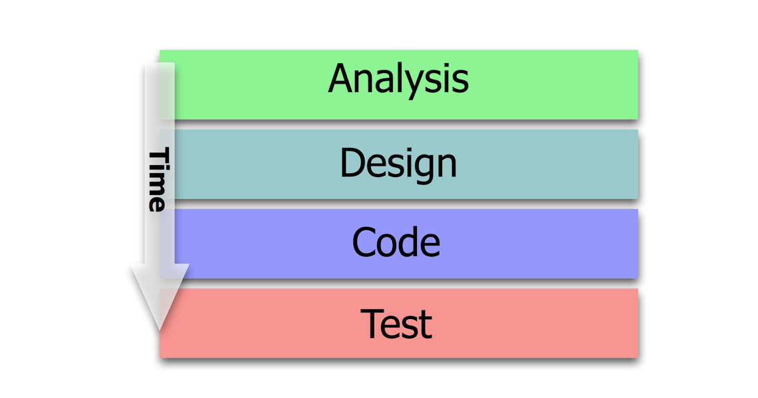
Traditional Software Development

Slide 19
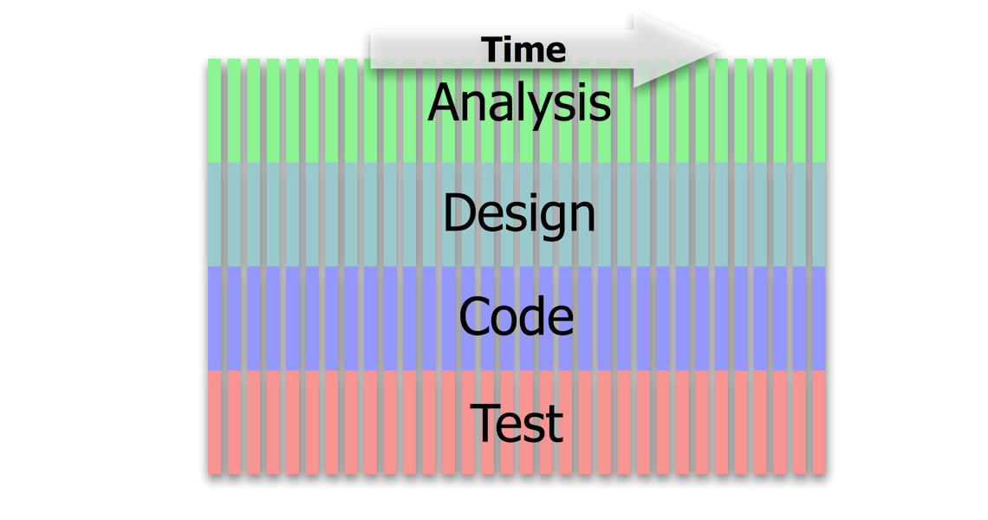
Applying Lean Principles to Software Development ... ( a better way of doing the same)
End-to-End small slices of work

Slide 20
Agile Model
The Agile model puts emphasis on the fact that whole Agile team should be a tightly integrated unit and is composed of
Developers
Quality assurance members
Testers
Project owner
Customer

Slide 21
Agile Model cont …
The key feature of ASD is to have effective communication between all team members. For valuable communication and information exchange, daily meetings are held in ASD.
Another important feature of agile process is iterative delivery.
An iteration or delivery cycle in ASD ranges from 1 – 4 weeks.

Slide 22
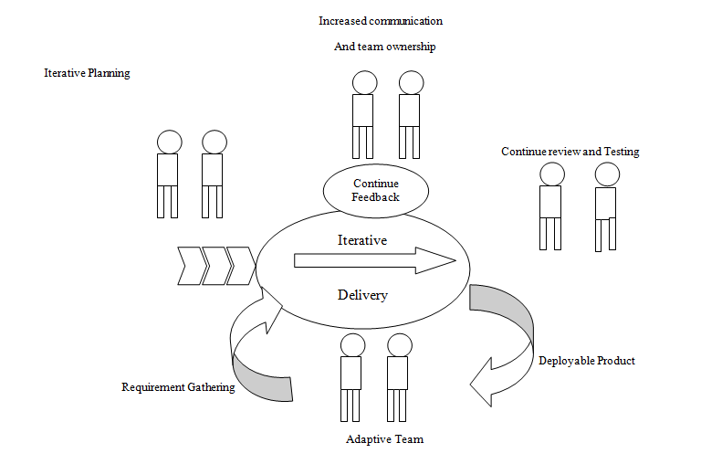
Agile Model cont …

Slide 23
Agile Model: Principal Techniques
User stories:
Simpler than use cases.
Metaphors:
Based on user stories, developers propose a common vision of what is required.
Spike:
Simple program to explore potential solutions.
Refactor:
Restructure code without affecting behavior, improve efficiency, structure, etc.

Slide 24
Agile Model: Nitty Gritty
At a time, only one increment is planned, developed, deployed at the customer site.
No long-term plans are made.
An iteration may not add significant functionality,
But still a new release is invariably made at the end of each iteration
Delivered to the customer for regular use.

Slide 25
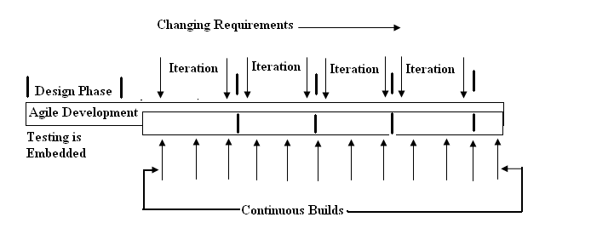
Agile Software Development Life Cycle

Slide 26
Stakeholders in Agile Life Cycle
Agile SDLC includes specific activities performed by manager (M), developers (D), testers (T), marketing professional (MP) and customer (C).
Table 1 lists the activities performed by different stakeholders
At the time of production of the code or before producing the code, testing is applied by writing failed test cases, unlike the traditional approach of working.

Slide 27
Stakeholders in Agile Life Cycle
Testing activity begins as soon as user stories (requirements) are finalized and prioritized, and
testers try to move business logic into lower levels in order to test with lower effort in the last stage.

Slide 28
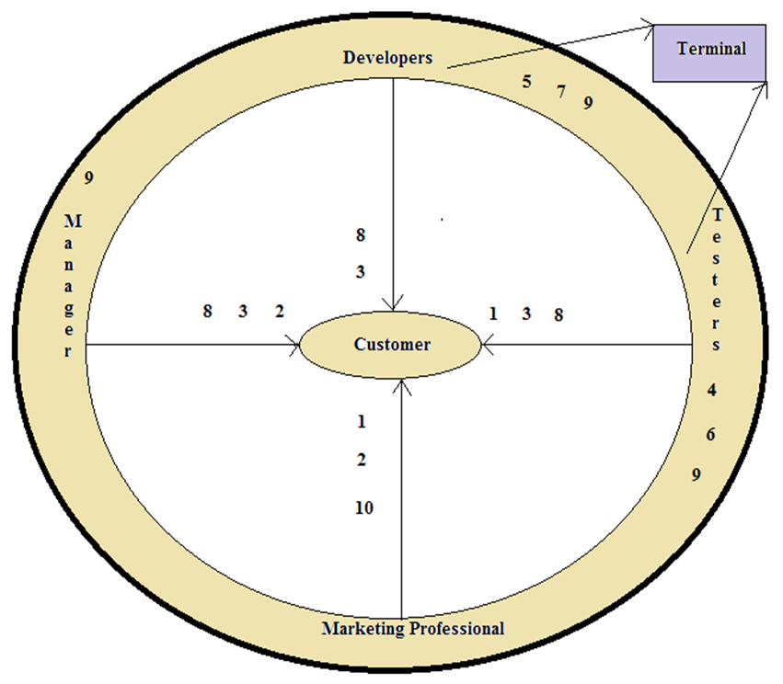
Stakeholders in agile life cycle
Fig 3: Stakeholders in agile life cycle

Slide 29
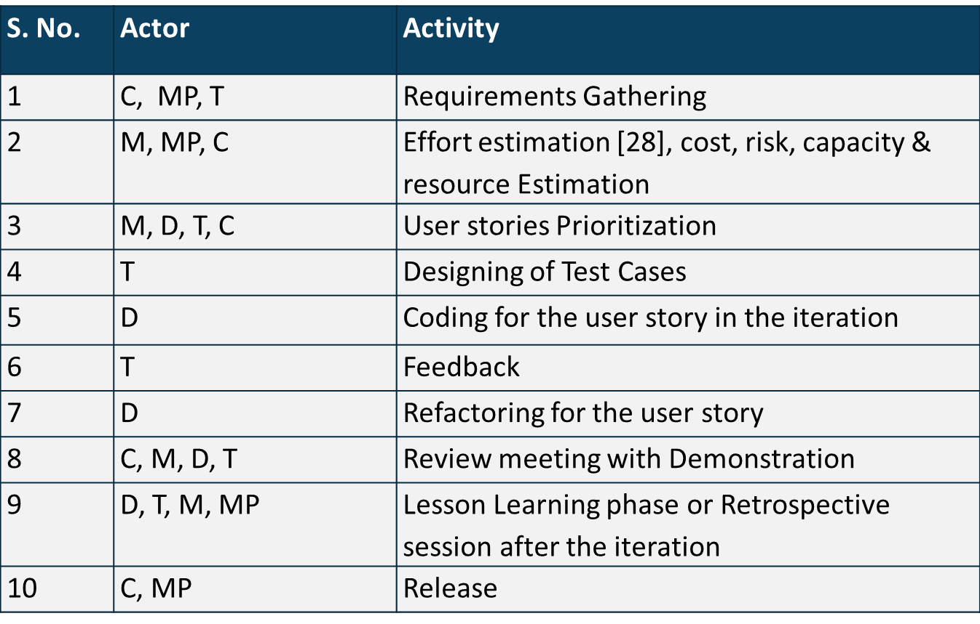
Table 1 : Actor Activity Chart - Agile Life Cycle

Slide 30
Agile software development life cycle
In agile, a quality(Q) product is delivered by operational teams, and acceptance factor (A) is related to the rate at which customer accepts the delivered product.
Effectiveness (E) of the team is related to two factors as shown in below equation
E = Q x A

Slide 31
Agile software development life cycle cont…
Out of these 2 factors, quality is more significant as acceptance is totally dependent on Q.
Q is more when there is lesser number of backlogs and it is less when backlog items are more.
Backlogs can be decreased when automation is the preferred approach over a manual way of testing.

Slide 32
Methodology
Face-to-face communication is favoured over written documents.
To facilitate face-to-face communication,
Development team should share a single office space.
Team size is deliberately kept small (5-9 people).
This makes the agile model most suited to the development of small projects.

Slide 33
Effectiveness of Communication Modes
Notes:
Software development is a communication game
Documentation is the worst way to communicate
Whatever your situation, use the most effective means at your disposal to communicate
http://www.agilemodeling.com/essays/communication.htm

Slide 34
Agile Model: Principles
The primary measure of progress:
Incremental release of working software
Important principles behind agile model:
Frequent delivery of versions --- once every few weeks.
Requirements change requests are easily accommodated.
Close cooperation between customers and developers.
Face-to-face communication among team members.

Slide 35
Agile Documentation
Travel light:
You need far less documentation than you think.
Agile documents:
Are concise
Describe information that is less likely to change
Describe “good things to know”
Are sufficiently accurate, consistent, and detailed
Valid reasons to document:
Project stakeholders require it
To define a contract model
To support communication with an external group
To think something through

Slide 36
Agile Software Requirements Management

Slide 37
Adoption Detractors
Sketchy definitions, make it possible to have
Inconsistent and diverse definitions
High quality people skills required
Short iterations inhibit long-term perspective
Higher risks due to feature creep:
Harder to manage feature creep and customer expectations
Difficult to quantify cost, time, quality.
Notes:
Why not more adoption (in SE? in corporate? In universities?)
Inconsistent and diverse defs – need more quality methodology not just quantity.
Lack of Theoretical Grounding – current concept of agility based on experience, not on underlying concepts like flexibility and leanness. Agile methods like SCRUM and XP are derived from subjective practical experience and not reliable systematic research.
But there is hope… Conboy et. Al. and their framework of agility for software development (based on underlying concepts);
Role changes – management role less prominent and active, more like a coach
Situational customization – no out of the box operation. Takes time to customize a process and get good at it.
Difficult to quantify – Agile practices are more philosophy based not activity based.
Risks – Making the customer understand the tradeoffs for following them down a rabbit hole can be difficult.
How do you budget a project if you can’t get the all/most requirements upfront?

Slide 38
Agile Model Shortcomings
Derives agility through developing tacit knowledge within the team, rather than any formal document:
Can be misinterpreted…
External review difficult to get…
When project is complete, and team disperses, maintenance becomes difficult…

Slide 39
Agile Model vs Waterfall Model
Steps of Waterfall model are a planned sequence:
Requirements-capture, analysis, design, coding, and testing .
Progress is measured in terms of delivered artefacts:
Requirement specifications, design documents, test plans, code reviews, etc.
In contrast agile model sequences:
Delivery of working versions of a product in several increments.

Slide 40
Agile Model vs Waterfall Model cont …
As regards to similarity:
We can say that Agile teams use the waterfall model on a small scale.

Slide 41
Summary
Discussed the basics of agile software development.
Highlighted some existing agile methodologies.
Discussed the agile model in detail.
Explained the Agile Software Development Life Cycle.
Presented some of the shortcomings of agile model.
Compared Agile Model vs Waterfall Model.

Slide 42
References
Rajib Mall, Fundamentals of Software Engineering, Fifth Edition, PHI, 2018.
Naresh Chauhan, Software Testing: Principles and Practices, (Chapter – 16), Second Edition, Oxford University Press, 2018.

Slide 43
Thank You

